Slide 1

Environmental Audio Scene And Event Recognition
Batch : B10
Guide : Prof. Pradnesh Bhisikar
College : Sandip Institute Of Technology And Research Center
Dept : Dept Of Computer Engineering

Slide 2
Introduction :
Monitoring human and social activities is becoming increasingly pervasive in our living environments. Automated systems, that use multimodal techniques employing both video and audio information, have recently gained importance. When visual cues cannot reliably recognize the activities (events) and environments/contexts, audio cues are complementary to visual cues. The information collected from a semantic audio analysis can be beneficial and related applications such as analyzing and forecasting patterns of events, classifying/searching audio records, customer alerts, and robot navigation.

Slide 3
Problem Statement :
Build an environmental audio scene and event recognition system which recognizes scenes and events solely on the basis of audio. And classify the given audio event and audio scene on the basis of its credibility towards children which helps to understand impact of the event on children.

Slide 4
Objective :
1. Recognizing scene of the environment in child
care center, elder homes, orphanages.
2. Classify Sound event using Audio as the primary Information.
3. Label the scene using environmental Audio Scene And Event Recognition .

Slide 5
Scope :
Audio signal processing has a myriad of research problems to focus on.
Scientists from NASA,ISRO and various private organizations are researching on audio everyday to find various ways to utilize it more efficiently.
We have already seen some awesome products like real-time translators and personal assistants systems already.
After research it’s quite fascinating the potential that audio processing holds.

Slide 6
Technologies used :
1. Python 3.6 or more
2. Libraries & packages :
1. Tensorflow
2. Keras
3. Librosa
4. Numpy etc.,
3.Development Tools:
1.Visual studio code

Slide 7
Algorithms & Models :
Model:
Sequential Model
Algorithms:
Spectral gating algorithm
Optimization Algorithm : Adam Optimization Algorithm
Activation Function : Relu,Softmax
Loss function : Mean squared error

Slide 8
Methodology :
Various Audio will be collected from the sound Events.
The Collected Audio will be sent for Noise Reduction by means of which we could get much clearer output.
Collected Noise free Sound is further processed to extract features of the Scenario, which could be determined by classifying sound into further subdomains.
These subdomains will help us to recognize various Scenes from which credibility of the situation can be understood.
If Situation tends to be some unethical, dangerous or could be accidental .
On behalf of which preventive measures could be taken.And further the Situation will be labelled to avoid repetition of such instance.
Situations will also be labelled if they are ethical or good for the premise.

Slide 9
Workflow Diagram :
Testing Dataset
Training Dataset
Data Preprocessing & Feature Extraction
Data Split into training and test data
Data Collection
ML Model training
ML Model Validation
Predictions
Deployment
Model Building Phase

Slide 10
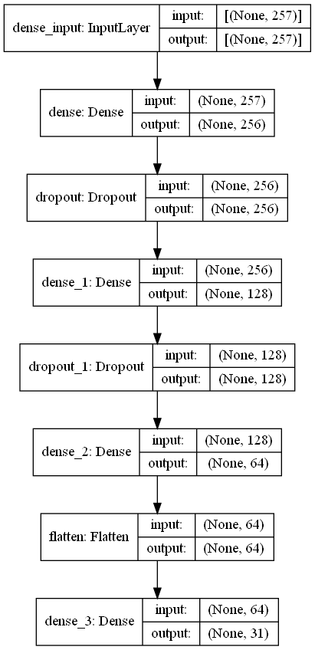
Neural Network Architecture :

Slide 11
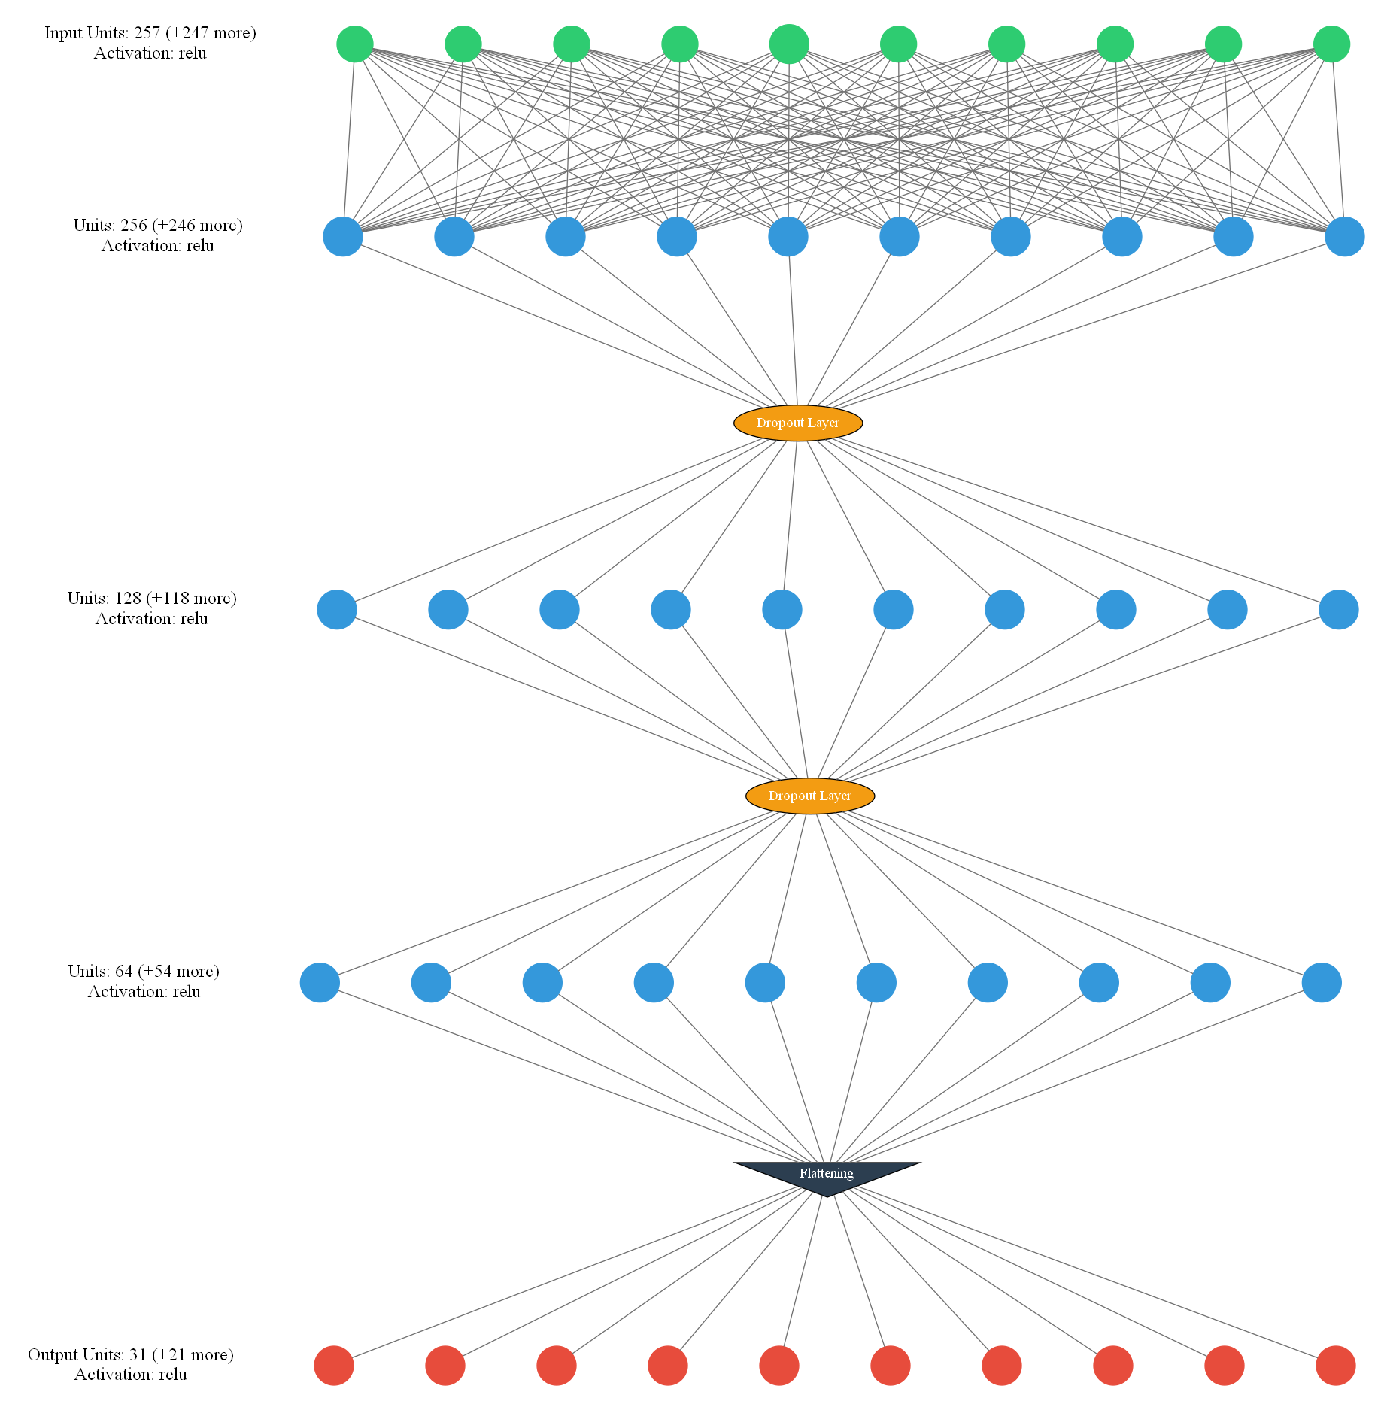
NN Graph :

Slide 12

Use Case Diagram :
System
Gather known and unknown data
Prepare dataset
Admin
Admin
Tester
Tester
Delete Dataset
Choose algorithm and validation method
Create,Examine and Update until satisfied
Use model with new data for prediction
Developer
Developer
End User

Slide 13
Experiments and results :
1st Generation
We had built a 7 layer CNN model with Adam optimizer, Categorical crossentrophy as loss function and 100 epochs we got training accuracy of 65.43 % and validation accuracy of 15.03%.
2nd Generation
In 2nd generation we built a CNN model with 5 layers with Adam optimizer, sparse categorical cross entropy as loss function and 200 epochs resulting in training accuracy of 64.12% and validation accuracy of 19.04%
3rd Generation
In 3rd generation ,we built a 4 layer model having all 4 dense layers with mean squared error as loss function, adam optimizer, and relu,softmax as activation functions giving training accuracy of 80.45% and validation accuracy of 25.3%

Slide 14
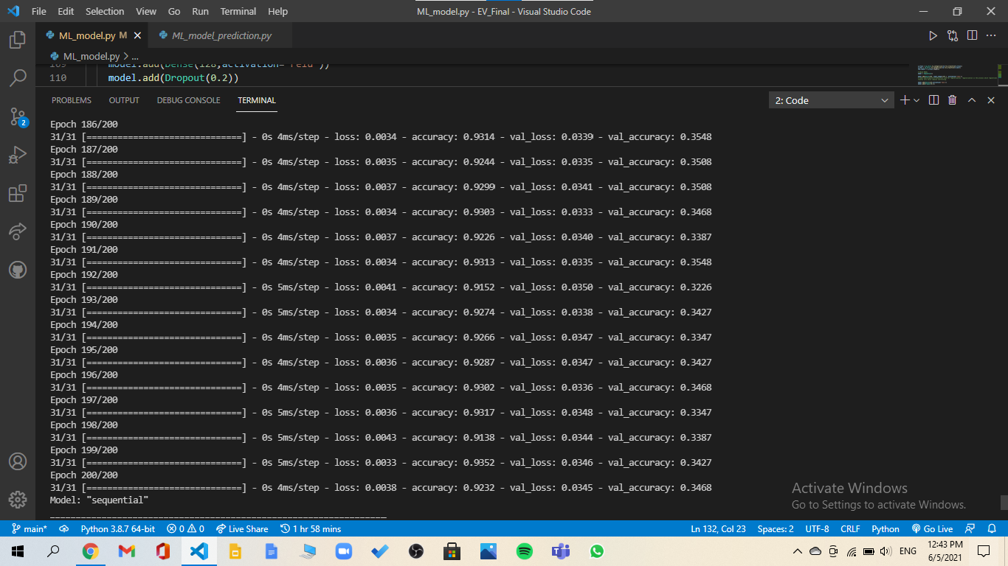
4th Generation
For 4th generation we added a single dropout layer and a flattening layer to reduce the overfitting along with previous generations specs as it is resulting in a whopping accuracy of 92.32% and validation accuracy of 34.68%

Slide 15
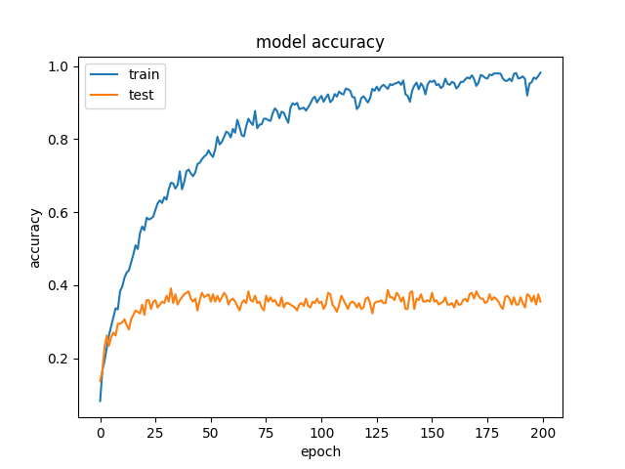
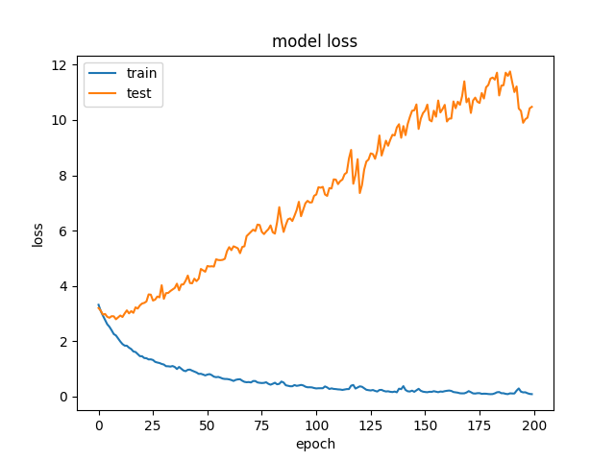
5th Generation
In 5th generation we used categorical crossentrophy as loss function, it resulted in accuracy of more than 90% but it was also yielding higher validation loss as compared to other generations

Slide 16
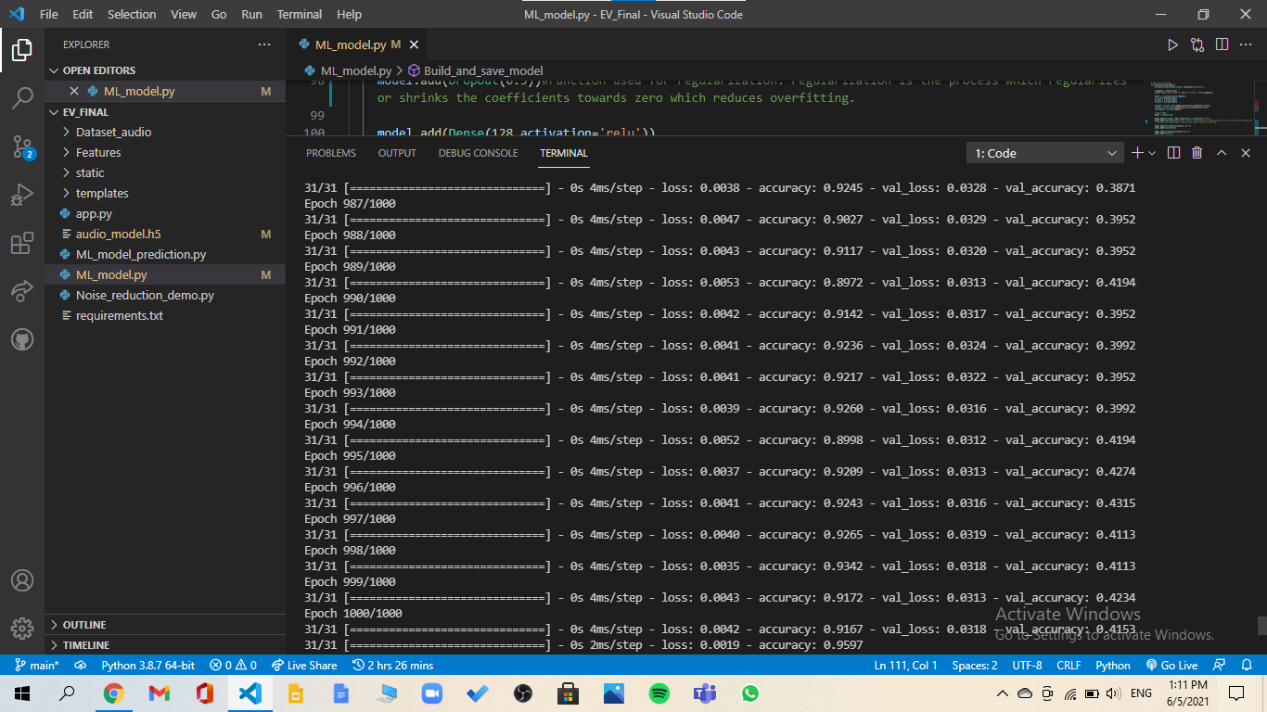
6th Generation
This is the latest generation we have tested so far and the best generation we have build. With similar specs as in 4th generation along with an extra dropout layer it resulted in training accuracy of 95.97% and first time we got validation accuracy more than 40% (specifically speaking 41.53%)

Slide 17
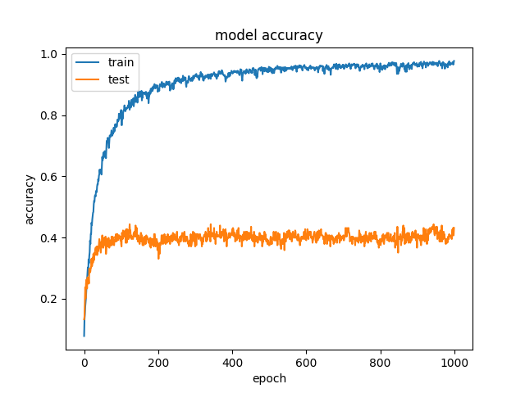
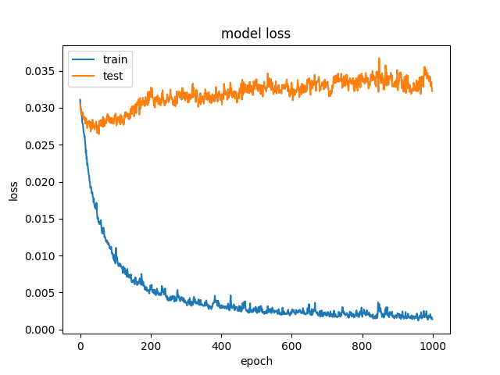

Slide 18
Future Scope
Many techniques have not been studied closer in this thesis and more work can be done.Below is a list of possible directions to work in this domain:
Implement more efficient and accurate model
Use another training set to get better performance while training.If we use better training dataset or more no of audio clips to train model it’ll yield a better results.
This kind of models can be used in surveillance systems in future ,which will help to build better surveillance systems in future

Slide 19
Conclusion :
Audio processing is a vast field to study in future.Audio classification is complex and many problems should be considered while working .In contrast to this we have worked on solving the problem of recognizing various audio files mostly related to a child care center using machine learning.
So, We have built a generative model for the purpose of audio recognition using CNN and a basic system based on model which will determine various audio files based on the input given to the system.

Slide 20
References:
•N. Takahashi, M. Gygli , and L. Van Gool, “AENET: Learning deep audio features for video analysis,” IEEE Transactions on Multimedia, vol. 20, no. 3, pp. 513 524, 2018.
•Generative Model Driven Representation Learning in a Hybrid Framework for Environmental Audio Scene and Sound Event Recognition. S.L.Jayalakshmi, S.Chandrakala. IEEE Transactions on Multimedia ( Volume:22, Issue: 1 , Jan.
•Q. Kong, Y. Xu, I. Sobieraj, W. Wang, and M. D. Plumbley , “Sound event detection and time frequency segmentation from weakly labeled data,” IEEE/ACM Transactions on Audio, Speech and Language Processing (TASLP), vol. 27, no. 4, pp. 777 787, 2019.
J. Ren, X. Jiang, J. Yuan, and N. Magnenat Thalmann, “Sound event classification using robust texture features for robot hearing.” IEEE Trans. Multimedia, vol. 19, no. 3, pp. 447458, 2017.
•L. Jing, B. Liu, J. Choi, A. Janin, J. Bernd, M. W. Mahoney, and G. Friedland, “DCAR: A discriminative and compact audio representation for audio processing,” IEEE Transactions on Multimedia, vol. 19, no. 12, pp. 2637 2650, 2017.
•H. Malik, “Acoustic environment identification and its applications to audio forensics,”IEEE Transactions on Information Forensics and Security, vol. 8, no. 11, pp. 1827 1837,2013.
•D. Stowell, D. Giannoulis, E. Benetos , M. Lagrange, and M. Plumbley , “Detection and classification of acoustic scenes and events,” IEEE Transactions on Multimedia, vol. 17, no.10, pp. 1733 1746, 2015.
•G. Mafra, N. Duong, A. Ozerov, and P. Perez , “Acoustic scene classification: an evaluation of an extremely compact feature representation,” in Detection and Classification of Acoustic Scenes and Events, 2016.
•Y Xu, Q. Huang, W. Wang, P. Foster, S. Sigtia , P. J. Jackson, and M. Plumbley ,“Unsupervised feature learning based on deep models for environmental audio tagging,”IEEE/ACM Transactions on Audio, Speech, and Language Processing, vol. 25, no. 6, pp.1230 1241, 2017.

Slide 21
Presented By :
Shubham Thombare
2. Kunal Sonar
3. Ankush Soni
4. Vishal Kajale

Slide 22
Thank You!

